Slide 1
Intercultural communication in cross-border teams
A Crossborder Journalism Campus Lecture

Slide 2
Collaboration starts with… me!
Lecturer introduction
Where have I lived? What is my cultural background? What’s the lense through which I see the world?
In which journalism culture have I been educated and socialised?
What’s my journalism experience and focus?
And what does that say about my blank spots?
➔ Being aware and being able to describe own background is the starting point to intercultural communication.

Slide 3
Cultures? Observe like an anthropologist
Clothing
Language
Excuses
Jokes
Social indicators
Rituals and routines
Smiling
Rules and taboos
Greetings
…
➔ What are cultures? National, societal, professional…
Notes:
A few examples to be discussed:
Clothing – indicates wealth or poverty, hierarchy casual/formal etc – when all suits look alike, study the shoes to see whether there is money
Language – casual/formal, loud/smooth, eloquent/full of stereotypes
Social indicators – titles (or not)
Jokes – can lead to serious misunderstandings

Slide 4
Intercultural communication – schools of thinking
Functionalist
Trying to list characteristics
Fixed categories
”How to do business in country x”
Interpretative
Phenomena are symbols of world views
Reading and interpreting symbols lead to deeper understanding
”widening one’s horizon”
Notes:
Functionalist: Categories
Interpretative: Constant dialogue

Slide 5
Example: ”…get to the point, please”
High context communication
implicit
polite
formal
relations built over longer time
important not to lose face
Low context communication
explicit
direct
”get to the point, please”
impolite to waste other people’s time
Notes:
When we meet online, we have to be more direct and explicit – this is not culturally neutral

Slide 6
Example: Different times
Polychronic time
Doing many things at a time
Things are in flux – we all know that, don’t we?
Being obsessed with fixed appointments is considered rigid and unflexible
Monochronic time
Doing one thing at a time
Things need to get done on time
Being on time to an appointment is a very important sign of respect
Notes:
When we meet online, we need to be on time (otherwise the meeting is over). This is not culturally neutral.

Slide 7
Hofstede’s dimensions
Power distance
Individualism vs collectivism
Masculinity vs femininity
Uncertainty avoidance
Short or long term perspective
Indulgence vs restraint
Notes:
What can we as journalists use intercultural communication theories such as Hofstede’s for?
Trying to understand our own background
Trying to understand colleagues’ and sources’ backgrounds
Selecting story ideas => example nepotism and point 2 on individualism vs collectivism

Slide 8
Short group work #1
Make groups of 3-4 students and ensure to have minimum two different nationalities
Have a look at Hofstede’s dimensions, the high/low context communication and the mono/polychronic attitude to time. Select one or two of these aspects for your group. Discuss where you see yourself and your background. Do you recognise some of them? Are there differences in your group? Are there points where you would potentially disagree or misunderstand each other? How could this be solved? (15 minutes)
Prepare to share one or two of the aspects discussed in the group in the class (5 minutes presentation each group)
Shared discussion in class

Slide 9
How do we actually communicate?
Conversation
Intellectual talks, discussions
Small talk
Negotiation
Interview
Verbal fight…

Slide 10
Non-violent communication
Non-violent communication developed by Marshall B. Rosenberg, a US psychologist
Based upon the assumption that humans are compassionate beings trying to fulfil their basic needs without harming others
Non-violent communication is one of several communication methods
Rosenberg divides communication into steps, that help us to look at various elements in our communication, so we are more aware of how we communicate

Slide 11
Avoid communication-blockers
4 examples of communication blockers:
Enemy pictures
Moralistic judgements
Comparisons
Denying own responsibility

Slide 12
Rosenberg’s 4 elements in communication
Observing without judging
Identifying and expressing one’s feelings
Understanding and taking responsibility for one’s genuine needs
Expressing a plea to the other to help meet those needs

Slide 13
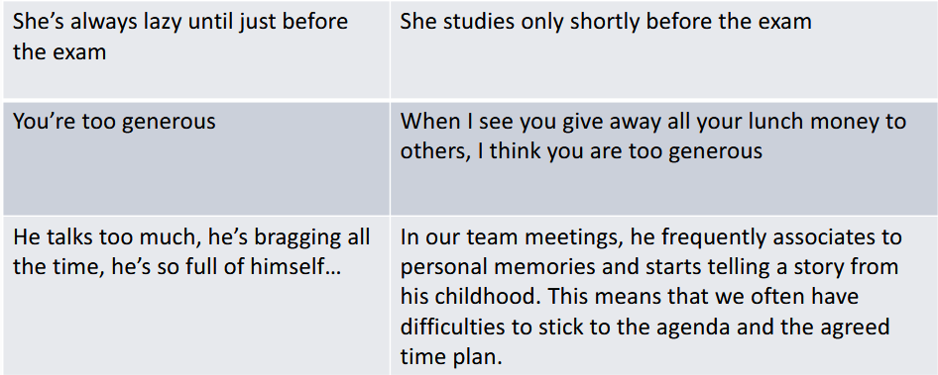
Observing without judging

Slide 14
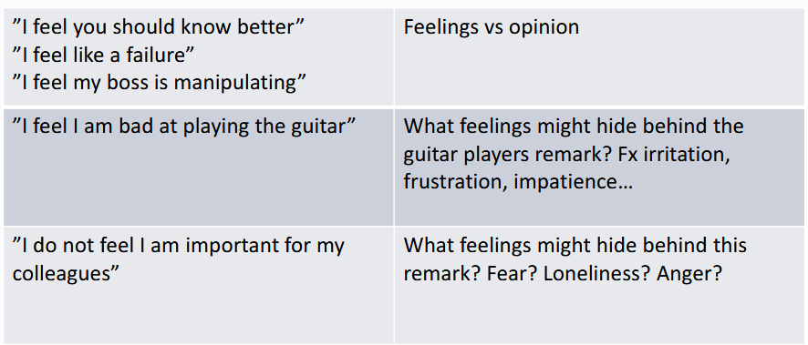
Identifying and expressing one’s feelings

Slide 15
Taking responsibility for one’s needs
Needs that are the deeper reason for our emotions:
Autonomy – we want to follow our own values, ideals, dreams and we want to chose how to get closer to them
Solemnity – make space to celebrate or to mourn
Integrity – meaning, autenticity, creativity
Mutual dependance – respect, recognition, love, support, trust, praise
Physical needs – touching, not having one’s life threatened, food, air, water, shelter, sexuality
Contemplation – harmony, beauty, inspiration, order, peace
Play

Slide 16
More about expressing our emotions
We are responsible for our own emotions – not for those of others
We can change ourselves – we can not change others
It may be painful to express emotions (and we may have been educated up not to express emotions: ”you know, we can not afford this”, ”come on, big boys/girls don’t cry” etc etc.)
Opressed emotions are damaging to persons and to relations

Slide 17
Expressing a plea for help to fulfill these needs
Thinking about a need
Describing the need
Mentioning the need as a plea (not as a demand or order)
Ask the other to repeat

Slide 18
Short group work #2
You can Make groups of 3-4 students and ensure to have minimum two different nationalities
Each think of yourself beginning in the new class/group. Pick one emotion (being curious, being overwhelmed, feeling shy, feeling optimistic – the first that comes to mind!).
Describe the emotion to your mates. Try to describe the underlying connected need. Is there something, you wish from your mates? Could you describe it?
Prepare sum up to the class: Was it difficult, easy? How did you do it? Examples welcome but not obligatory.

Slide 19
This is a presentation developed for the Crossborder Journalism Campus.
It can be used freely under Creative Commons BY NC SA.
For more material and teaching instructions on cross-border collaborative journalism, please visit: www.crossborderjournalismcampus.eu.
For further questions, reach out via the contact page.

Slide 20
Funded by the European Union. Views and opinions expressed are however those of the author(s) only and do not necessarily reflect those of the European Union or the European Education and Culture Executive Agency (EACEA). Neither the European Union nor EACEA can be held responsible for them.

