Slide 1
Cross border collaborative journalism method and mindset
A Crossborder Journalism Campus Lecture

Slide 2
Cross-border collaborative journalism
Cross-border journalism as a method
Step-by-step introduction
Cross-border journalism as a mindset Unbias the news
Thinking about cross-border journalism Practitioners and academics looking at cross-border journalism

Slide 3
Cross-border journalism as a method – a step-by-step introduction

Slide 4
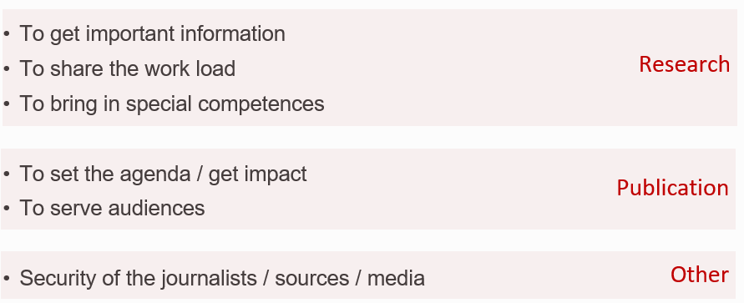
Why cross-border collaboration?
Notes:
For addressing the purpose question it is recommended to find examples from own, in-depht known or recent cross-border investigations to illustrate.

Slide 5
Cross-border collaborative journalism - definition
journalists from different countries
decide on an idea of mutual interest
gather and share material
publish to their own audiences
(Alfter, 2019)

Slide 6
Myth and reality
Myth
Crossborder journalism is based upon massive leaks that were given to journalists
To do crossborder journalism you must have a job at a big medium
Reality
Several prominent cross-border investigations have been dubbed ”leaks” or ”papers” - but few are based upon anonymous, unsolicited leaks
Publications via big media are most well-known, but there are scores of cross-border investigations elsewhere

Slide 7
Inspiration: Find some crossborder investigation examples
Compilations via networks, conferences, work grant organisations…
Dataharvest – European Investigative Journalism Conference
Investigative Journalism for EU grants
Journalismfund.eu
Investigate Europe
EIC network
ICIJ
OCCRP

Slide 8
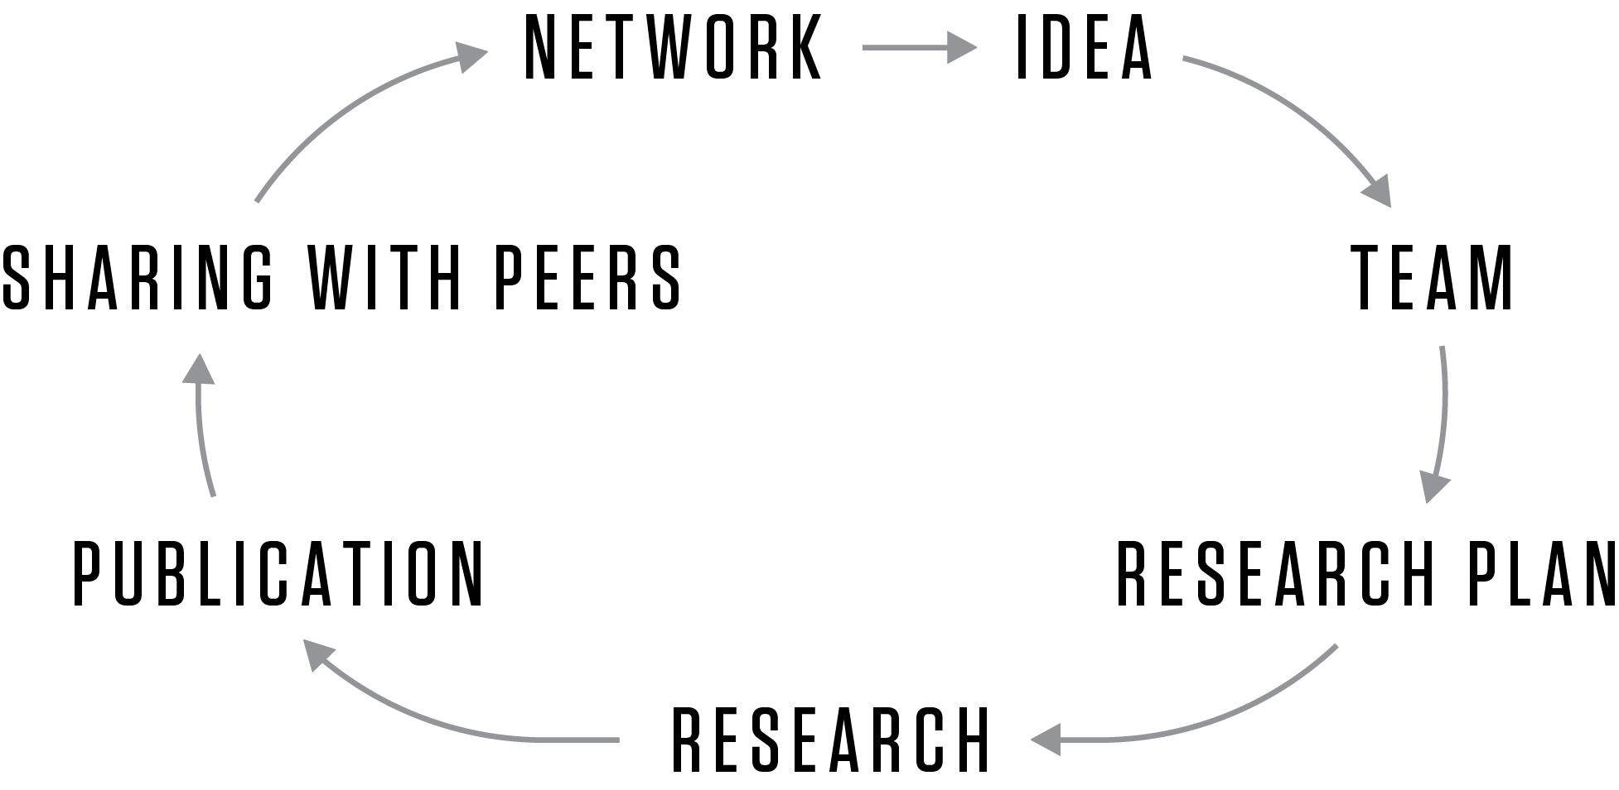
Cross-border journalism process wheel
(Alfter, 2015, 2019)

Slide 9
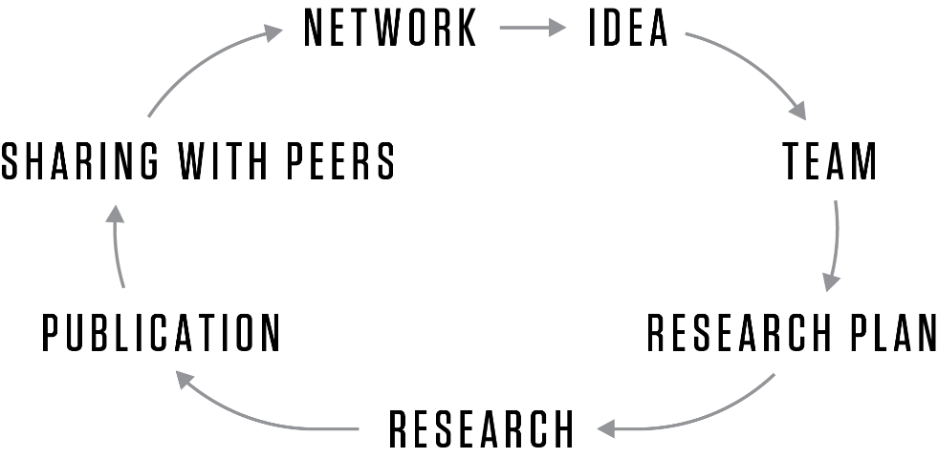

Slide 10
Looking for cross-border story ideas
Day-to-day: think across borders when relevant
Organisation stories: stories relate to bodies like the EU, WTO, NATO, UN and UN bodies, WHO, World Bank, EIB….
Chain stories:
story covers something happening in a chain of countries – for example trade, trafficking…
Comparative stories: similar stories occuring in several countries such education, school reforms, cultural, sociological, economic trends etc
Notes:
A method like others, only to applied when necessary.

Slide 11
What to consider for a good team
Hard competences
Language, country, experience with subject, important medium, network of sources, experience with institution
Soft competences
Trust, sympathy, wish and capability to cooperate, alignment on editorial vision, ethical tradition
ALWAYS REMEMBER: Create a win-win for all team members!!!

Slide 12
Hard work & enriching each other in the team
Use the differences
Different traditions for access to data, FOI /different traditions for access to sources / different political interests / overcoming bias
Journalism traditions
Hidden camera / How to deal with quotes, cross checking with sources? / Views on funding
Working rhythm and timing
Overview and focus
Fact checking / legal checks / ethics
Notes:
In the research phase, team members can supplement each others thanks to different competences, national traditions, access to information and sources etc.
Contextualisation is crucial, so all can learn from the others.
Challenges to consider are in the differences and work load:
There may be different work rhythms at the various media partners
Work load of team members may be different and vary over time
National / publication contexts may be different

Slide 13
The big moment… PUBLICATION!
Often the most difficult moment of the cooperation, remember to coordinate early in the planning
Story telling varies from country to country
Reaching different target groups
Findings need to be adapted to context
Bringing the story to the agenda – each team member and all together
Simultaneous or consecutive publishing – or both?
Security before and after publication
You are responsible to your audience!!!

Slide 14
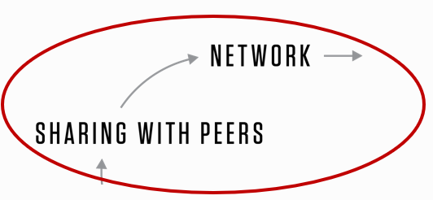
Sharing, networking
Sharing with peers means professional development
You share both your experience and your findings (pitching)
Consider sharing already while working (work diary)
When you share with peers, you position yourself in the community of journalists (networking)

Slide 15
Cross-border journalism as a mindset
- unbias the news

Slide 16
A bit of history
Cross-border collaborative journalism grown out of the investigative journalism community (and mindset)
“Muckraking” dates back to 1890-1920 with critical journalism describing the terrible social conditions in the US and holding government to account
Collaborations in the investigative community date back to the 1970ies with
In the late 1990es/early 2000, the first journalist driven cross-border collaborative journalism investigations were carried out on global level (example ICIJ Big Tobacco Smuggling) and European level Farmsubsidy network
Notes:
For the early stages of investigative journalism in the US, biographies of Nelly Bly, Julius Chambers – conditions for people in mental hospitals, Upton Sinclair on labour conditions in abbatoirs – may be of interest for illustration
For the early stages of collaborations, the Arizona Project may be of interest for illustration
For the first cross-border collaborations, the ICIJ’s 2000 publication on tobacco smuggling is an interesting example https://www.icij.org/investigations/big-tobacco-smuggling/ (global level), the Farmsubsidy.org project is an interesting example https://web.archive.org/web/20200713200726/https://farmsubsidy.org/about/ and https://web.archive.org/web/20170924210633/http://farmsubsidy.openspending.org/news/media/ (European level)

Slide 17
The concept of muckraking and our journalism
Meyer: Ideals of journalism, logics of journalism
Meyer: Dualistic system (determining whether something is true or not) vs. discoursive system (discussion as driving force to shared solutions) in “truthful exchanges among different points of view”
Grzeszyk (citing Chalaby): Anglo-style journalism revelations vs. European style argument
Grzeszyk: Cross-border collaboration as a way to call out bias.

Slide 18
Grzeszyk’s recommendations:
Know what you are excluding
Be transparent about your mission
Expect to find more than two sides of a story
Be aware of narratives
Embrace diversity

Slide 19
Investigative journalism and potential reactions
Luyendijk: Self-healing capacity of a democracy
What if journalists set the agenda with all these revelations of sad, worrying, outrageous things – and then nothing happens?
Hird: Impact reverse engineered
Case study from the moment of publication to the moment when some improvement actually occured – but what precisely happened in between?
Trusting News: Trust from the head and the heart
If there is a weak social bond, unveiling something scandalous can further distrust in society and institutions and thus destabilise.

Slide 20
Collaboration as a trend
Collaboration is a competence
In the 2020ies, collaboration in journalism is a competence applied in investigative journalism and beyond – way beyond! For example:
Unbias the News:
Various reportings across borders – from global climate inequality to feminism
Netherlands:
Collaboration competences to work on shared topics across municipality and regional borders in the same country
PFAS investigations:
Collaborations between journalists and scientists and (to some extend) civil society)

Slide 21
Thinking about cross-border journalism: Practitioners and academics looking at cross-border journalism

Slide 22
Reflection on cross-border collaborative journalism
How to define it: what is cross-border collaborative journalism?
How does cross-border collaborative journalism work?
Does cross-border journalism make a difference in society?
Who are the cross-border journalism actors and how do the power structures work?
Collaboration as a competence – whom do journalists collaborate with?
Comparative journalism studies, journalism cultures
….
List of academic and practitioners’ work in the field
https://journalismarena.eu/cross-border-collaborative-journalism-reading-material/

Slide 23
This is a presentation developed for the Crossborder Journalism Campus.
It can be used freely under Creative Commons BY NC SA.
For more material and teaching instructions on cross-border collaborative journalism, please visit: www.crossborderjournalismcampus.eu.
For further questions, reach out via the contact page.

Slide 24
Funded by the European Union. Views and opinions expressed are however those of the author(s) only and do not necessarily reflect those of the European Union or the European Education and Culture Executive Agency (EACEA). Neither the European Union nor EACEA can be held responsible for them.

