Slide 1
Getting going: the cross-border journalism
story idea
A Crossborder Journalism Campus Lecture

Slide 2
”A good story”
“Good stories” in general
Something new, not seen before
A connection not made public before
An element that was not known before
Something fun, apaling, different, unexpected
Something that is crucial to society
Underreported or only superficially reported topic
Understanding a paradox
Reconstructing a case
Understanding a structure
What cross-border stories often can add
Digging deeper in large and/or complex matters
Making complex and/or international matters relevant to more audiences

Slide 3
For inspiration: Where do ideas start
Affordable housing – a problem across Europe: The Cities for rent project
Affordable student housing – a problem across Europe: The Urban Journalism network investiation on student housing
PFAS pollution on national level only? The European map of PFAS sites
European legislation regulating in different national contexts: The case of waste regulation
Bumpy rails? An investigation into European rail infrastructure.

Slide 4
Where to go looking for cross-border story ideas
At your front door, on your local train, actuality stories – think across borders when relevant
Organisation stories – stories relate to bodies like the EU, WTO, NATO, UN and UN bodies, WHO, World Bank, EIB….
Chain stories – story covers something happening in a chain of countries – for example trade, trafficking…
Comparative stories – similar stories occuring in several countries such as public transport, school reforms, tax avoidance, whitewashing and corruption…

Slide 5
The art of developing good questions
Story idea development process
Generation of ideas – opening – creative, everything is allowed
Evaluation of ideas – closing – operational, reality check
Selection of ideas – editorial decisions

Slide 6
Opening and closing
Opening - associating
All thoughts and associations are welcome
Do not rank your ideas
Do not judge or evaluate your ideas
Think big – across borders and audiences
Closing – analysing
Select the best ideas
Weigh the pros and cons
Check whether an idea is realistic to carry out
Consider the time frame
Consider costs
Is the project important enough to justify the extra costs of a cross-border collaboration?

Slide 7
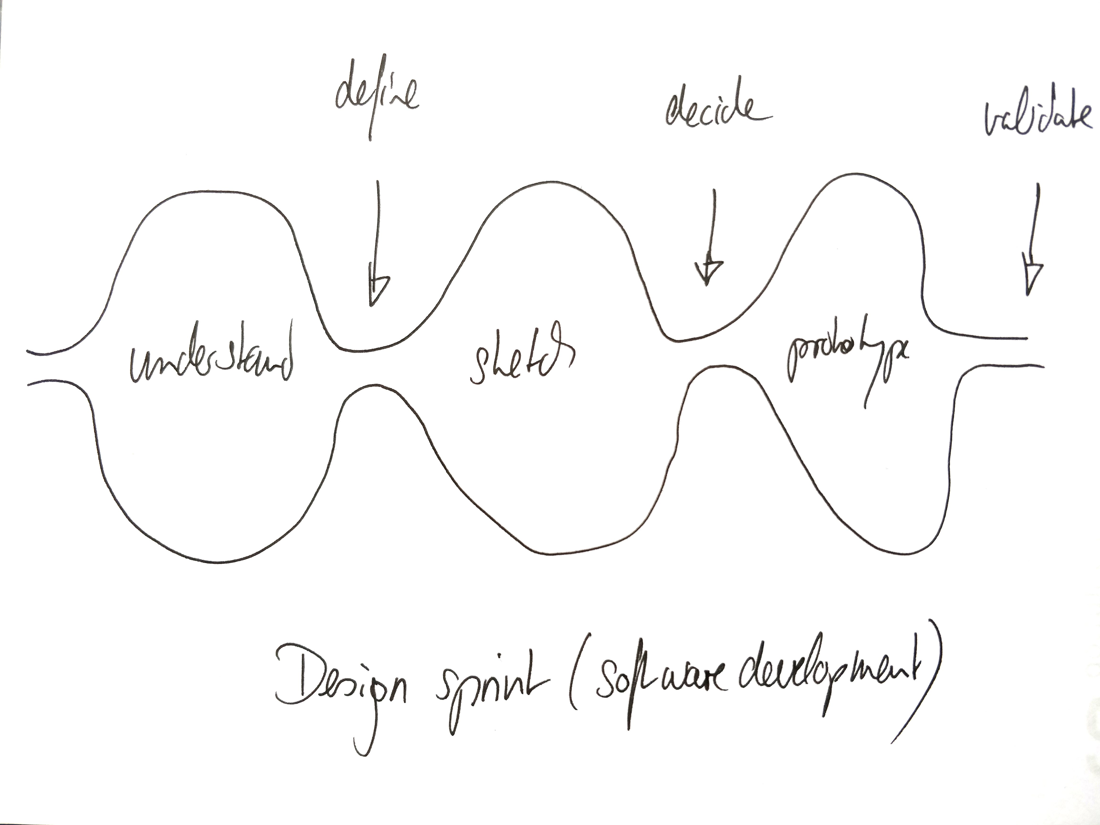
Inspired by design sprints
Some like the design sprint process description for the idea development and selection processes

Slide 8
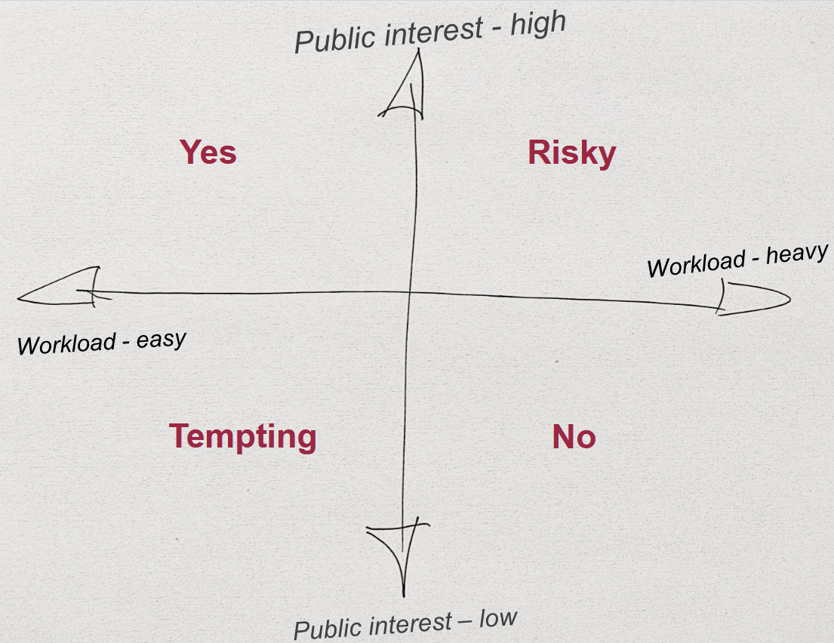
Selecting a story idea
Credit:
Hanson, Nils (2010). Grävande journalistik. Ordfront, Stockholm.

Slide 9
Support the process with pitches to your audiences
Hook – a catchy headline
Body – description of the idea
Selling point – what is unique with this idea
Summary – that’s it in short
For a cross-border story, remember pitches to all your target groups:
National target groups for each of your team members
Transnational target group for your summary and/or transnational story

Slide 10
This is a presentation developed for the Crossborder Journalism Campus.
It can be used freely under Creative Commons BY NC SA.
For more material and teaching instructions on cross-border collaborative journalism, please visit: www.crossborderjournalismcampus.eu.
For further questions, reach out via the contact page.

Slide 11
Funded by the European Union. Views and opinions expressed are however those of the author(s) only and do not necessarily reflect those of the European Union or the European Education and Culture Executive Agency (EACEA). Neither the European Union nor EACEA can be held responsible for them.

